Slide 1
APPLICATION
CASE STUDY
Group projects
R application to Consumer Behavior

Slide 2

Let’s start with a quick questionnaire !
https://toulousebs.eu.qualtrics.com/jfe/form/SV_3jF5YiT7fIUd1u6

Slide 3


Slide 4
Can you guess the purpose of the study ?

Slide 5
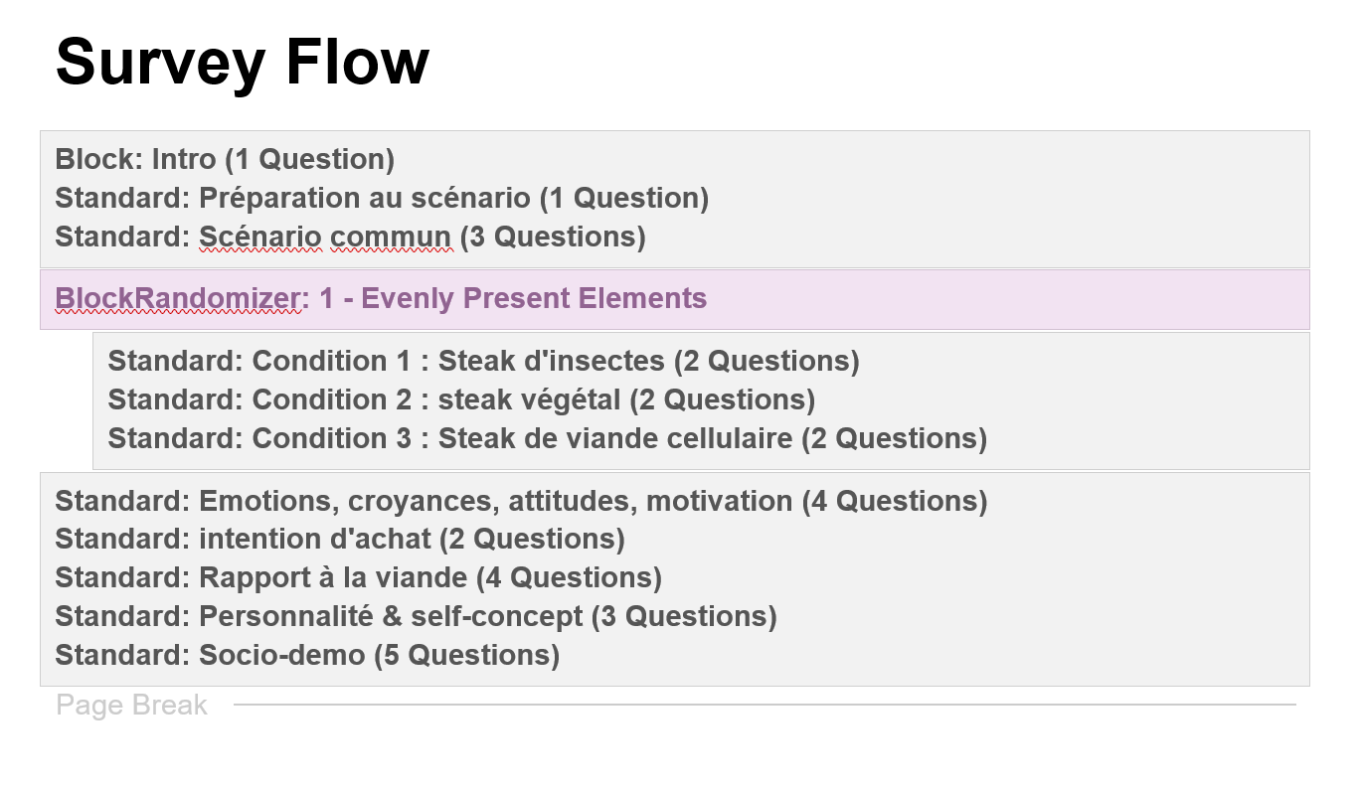
Presentation of the experiment

Slide 6
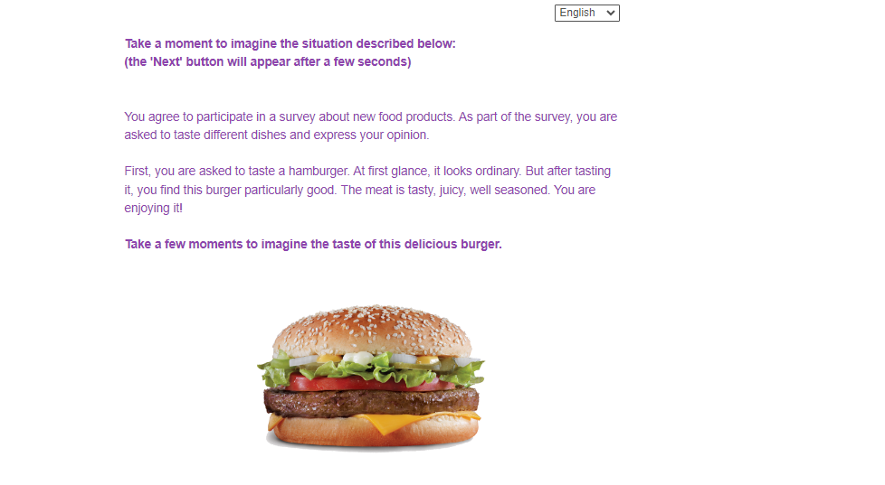
The projective scenario

Slide 7
Manipulated variable = the type of alternative to meat
Condition 1 : Plant-Based Steak
After the tasting is over, you learn that the meat inside the burger was not real meat but a plant-based steak made from pea protein.
Condition 2 : Insect Steak
After the tasting is over, you learn that the meat inside the burger was not real meat but a steak made from blended insects.
Condition 3 : Cellular Meat Steak
After the tasting is over, you learn that the meat inside the burger was not ordinary meat but a steak made from cellular meat, grown in vitro

Slide 8
Application: alternatives to meat

Slide 9
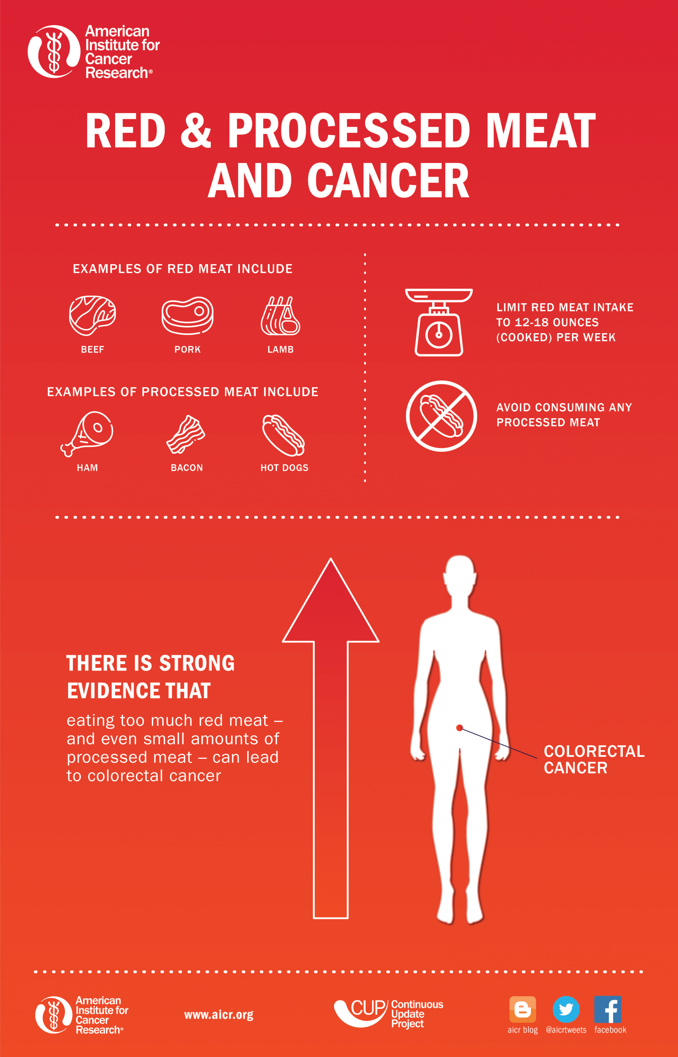
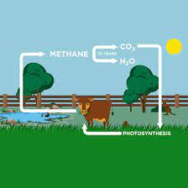
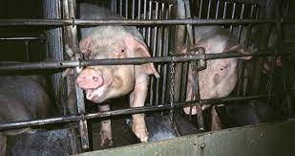
impact of meat consumption
climate
health
animal welfare

Slide 10
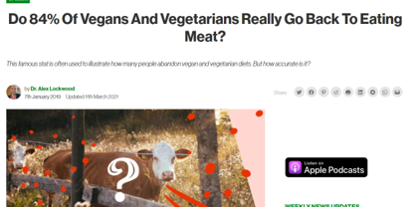
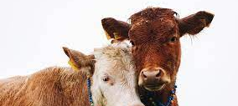
vegetarianism and veganism
Recent surge in rate of vegetarianism and veganism, especially among the millenials (The Economist 2018).
Main reason for becoming vegetarian or vegan is animal welfare (Ruby 2012).
Still, people have a hard time maintaining a vegetarian diet.

Slide 11
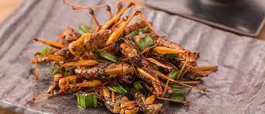
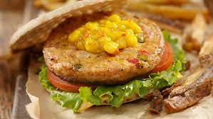
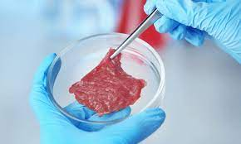
3 main alternatives to meat
Insects
Veggies
Cultured meat

Slide 12
insect burgers
Insects as food or edible insects are insect species used for human consumption, e.g., whole or as an ingredient in processed food products such as burger patties, pasta, or snacks.
The most commonly eaten insect groups globally, according to the FAO, are ants; beetles; bees; caterpillars; cicadas; crickets; dragonflies; flies; grasshoppers; leaf bugs; locusts; scale insects; termites; and wasps.
Exemples:
« BUG BURGER »: A burger where meat is replaced by a mix of mealworms and roots vegetables.
« NEATBALLS » : « Meatballs » made with insects and root vegetables. According to the creators, they are better served with mashed potatoes.
The « DOGLESS HOTDOG » where dried and glazed carrots are replacing meat.

Slide 13
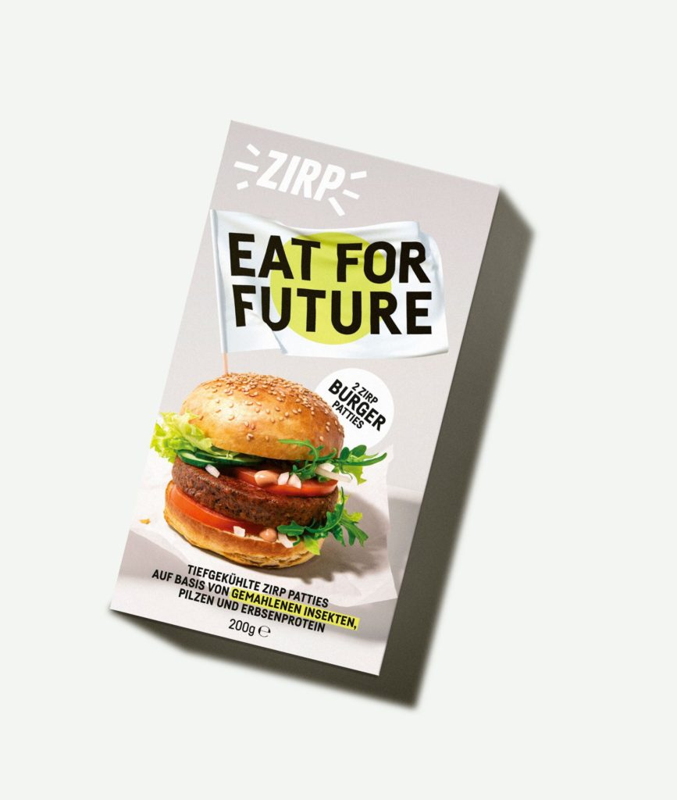
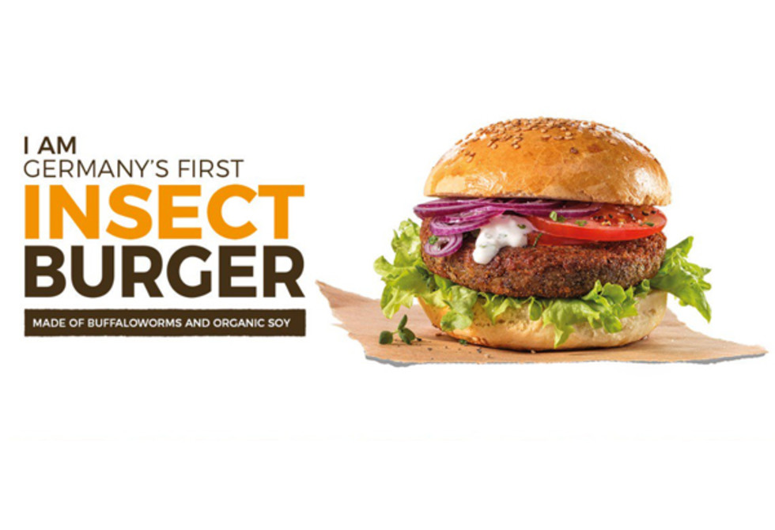
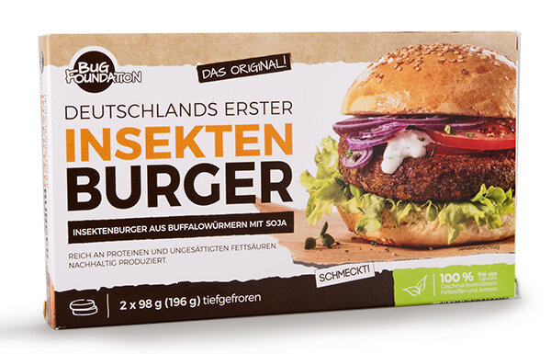
brand: Bug Foundation (Germany)
Notes:
https://www.youtube.com/watch?v=chHOPN_RnvI

Slide 14
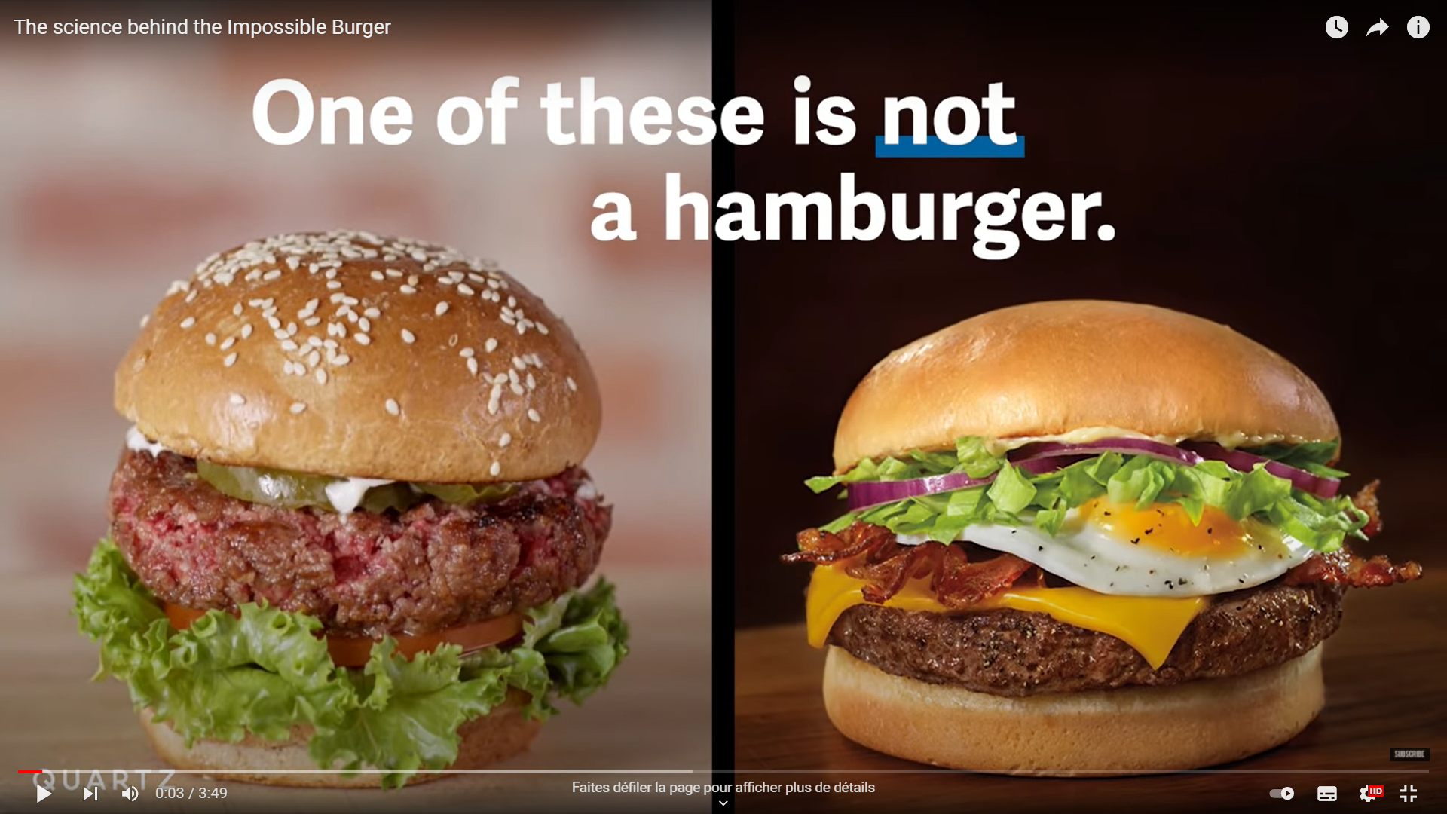
veggie burgers
Plant-based meat products grew in popularity by a whopping 463 percent in 2020. Plant-based burgers were also among the top 10 fastest-growing menu items, expanding by a jaw-dropping 362% in the past four years
Notes:
https://www.youtube.com/watch?v=ebNeUihciDI
https://impossiblefoods.com/blog/4-trends-that-are-defining-the-future-of-plant-based-food

Slide 15
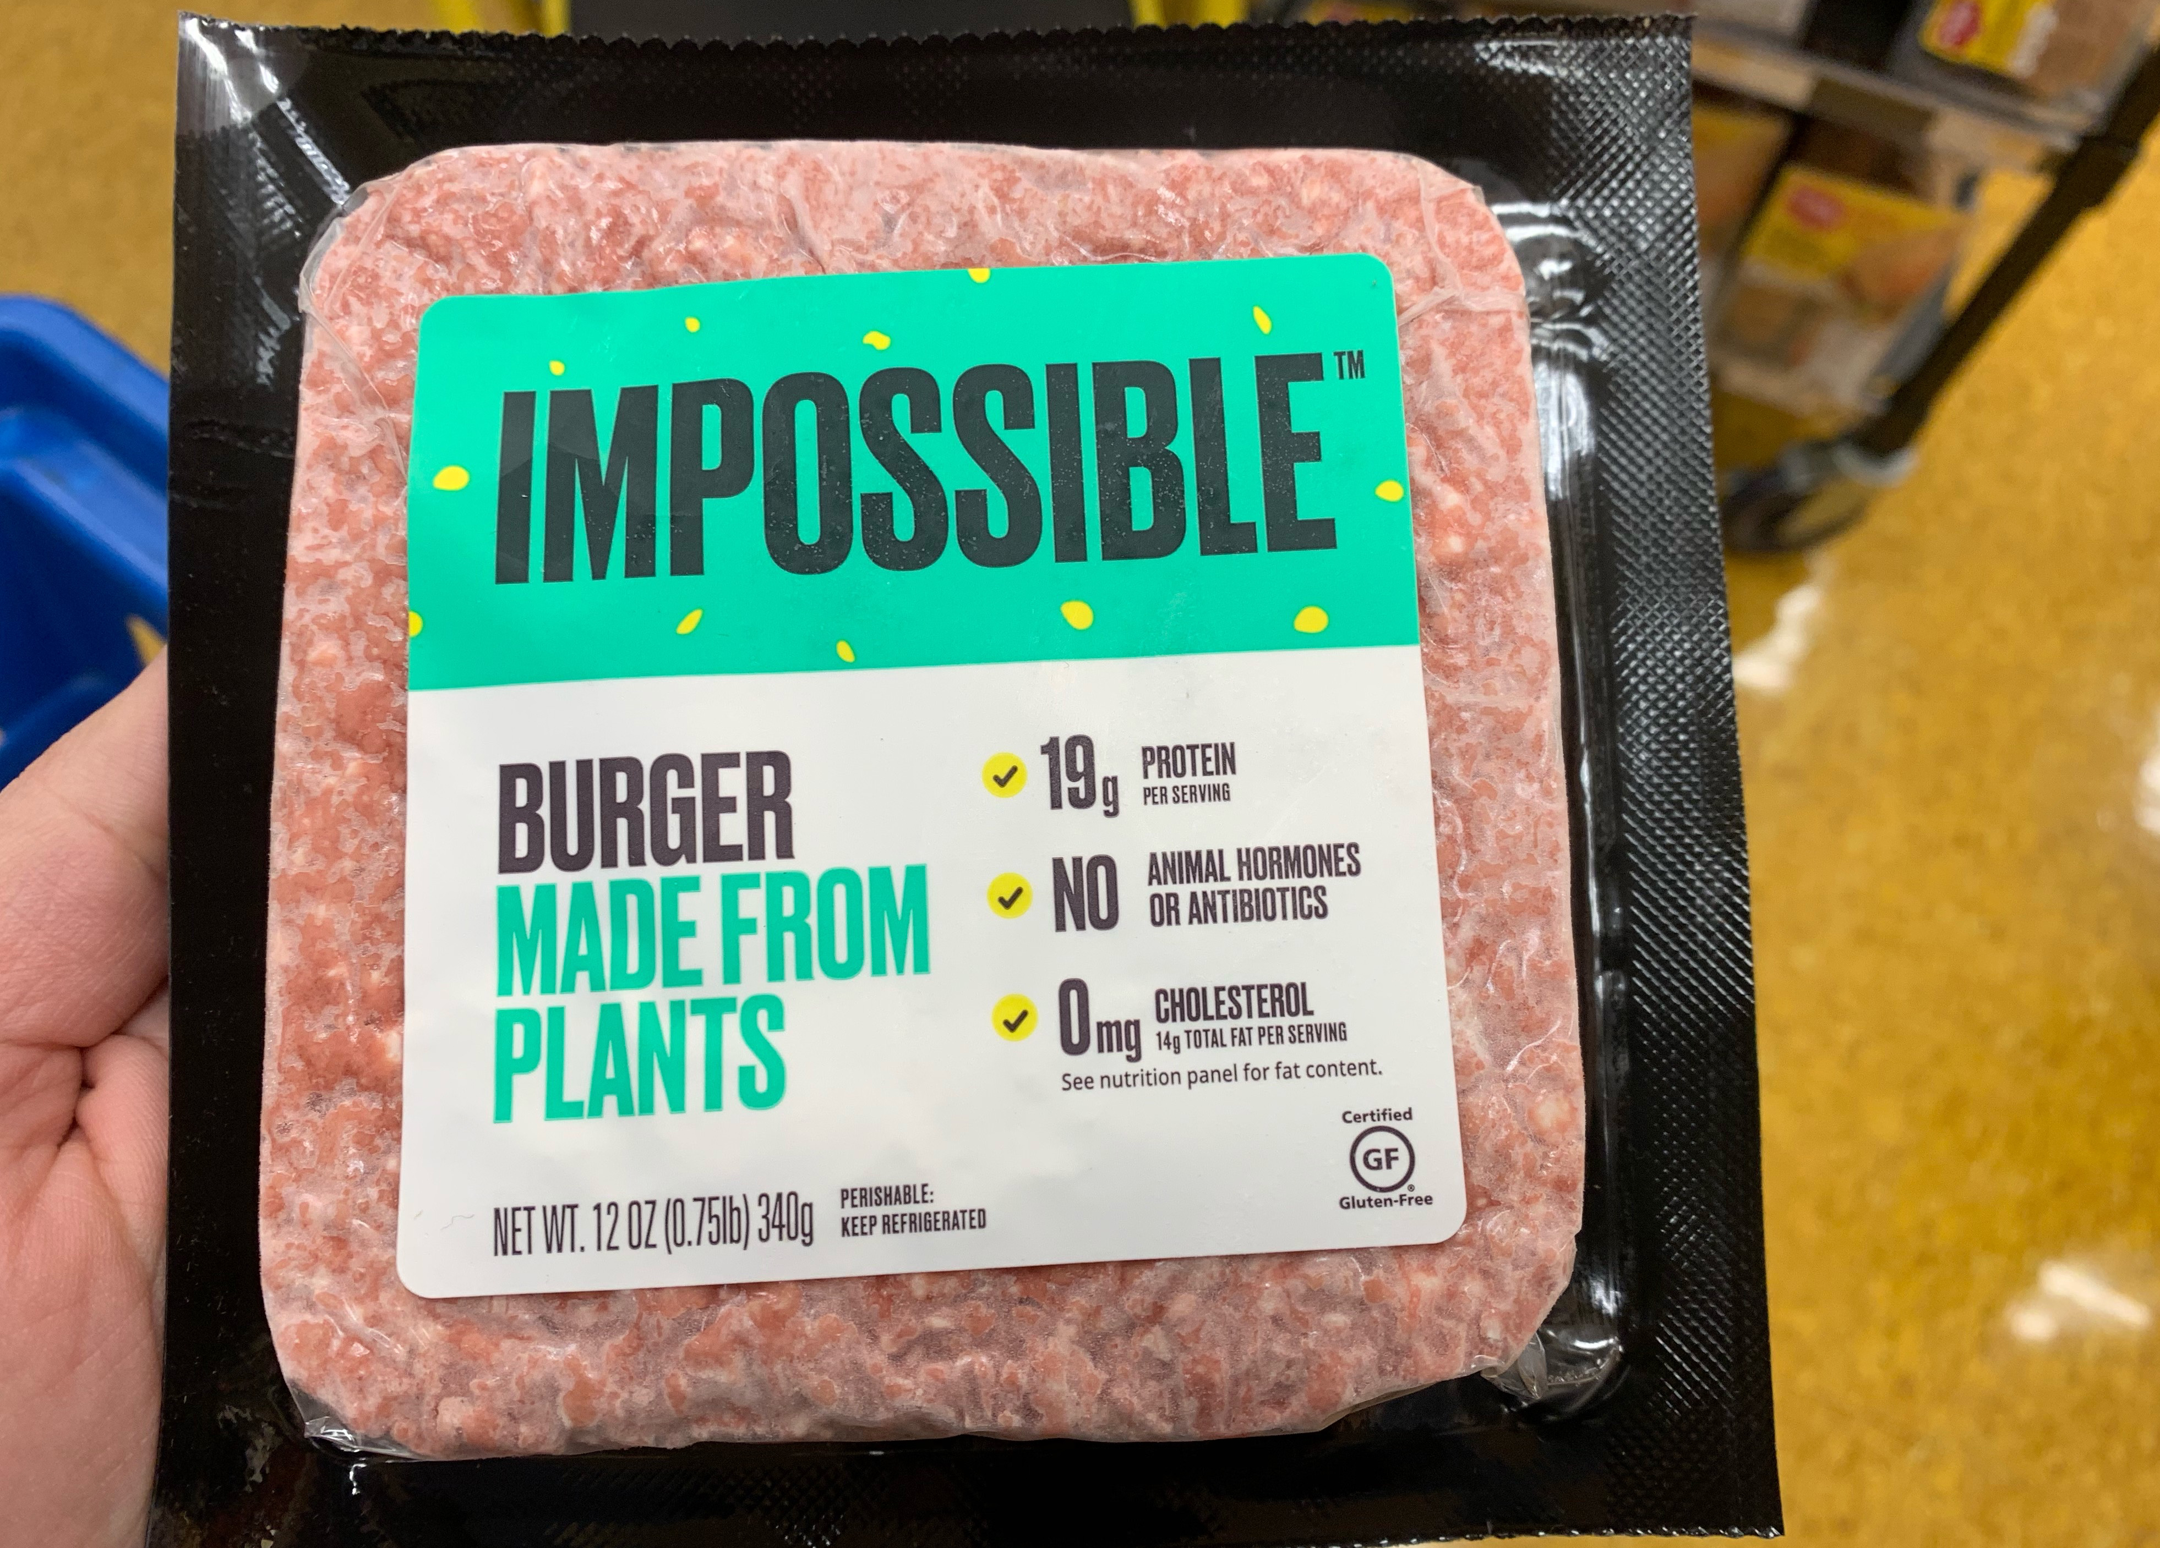
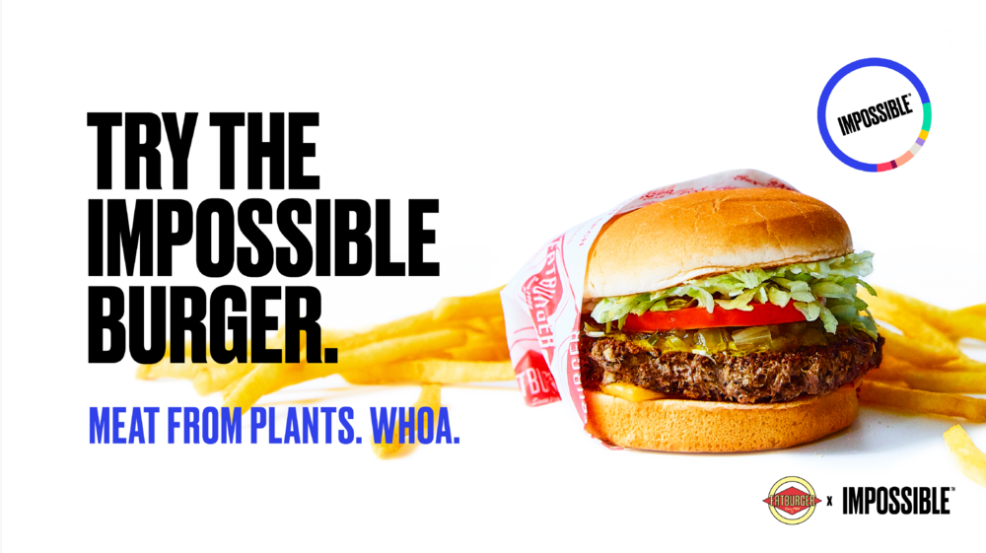
brand 1: Impossible (Us, California)

Slide 16
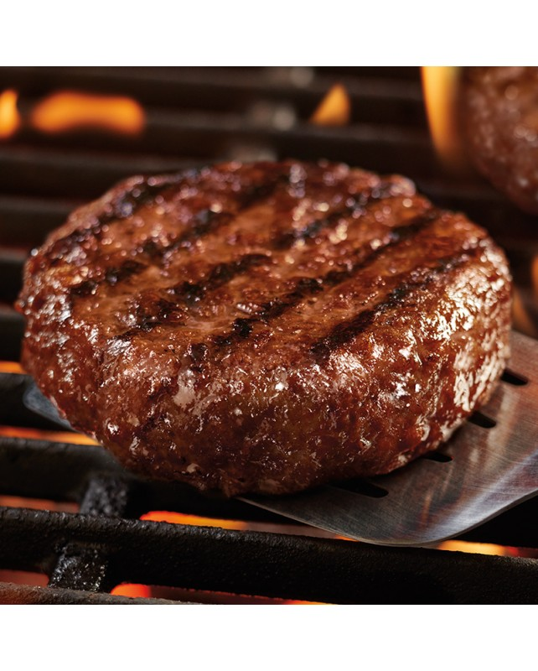
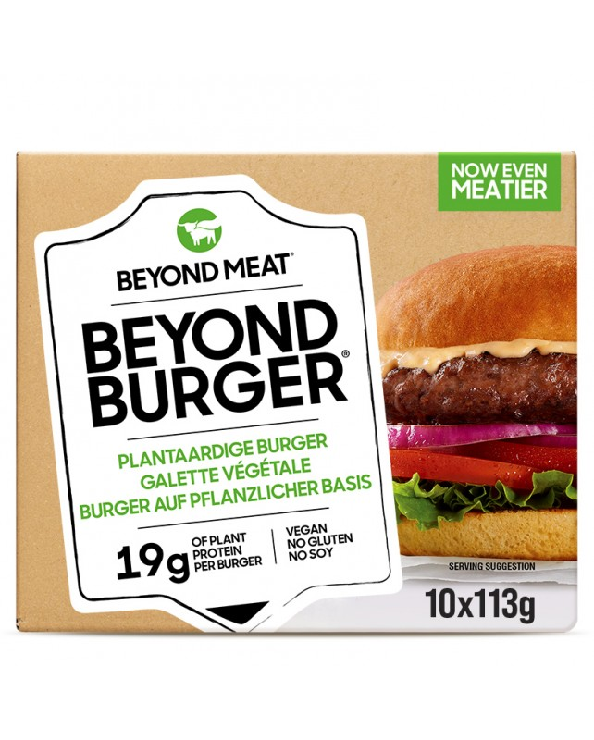
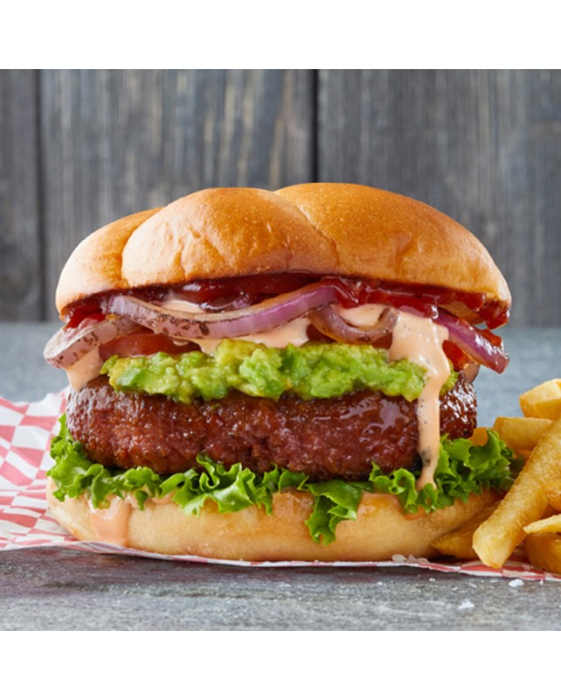
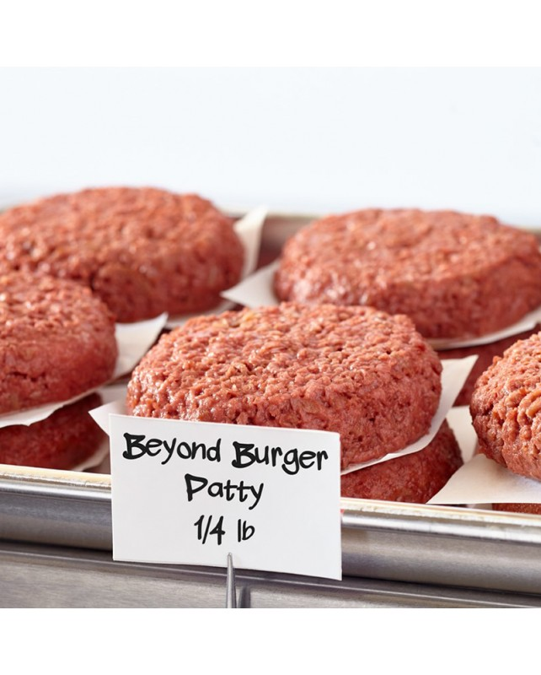
brand 2: Beyond Meat (US, California)

Slide 17
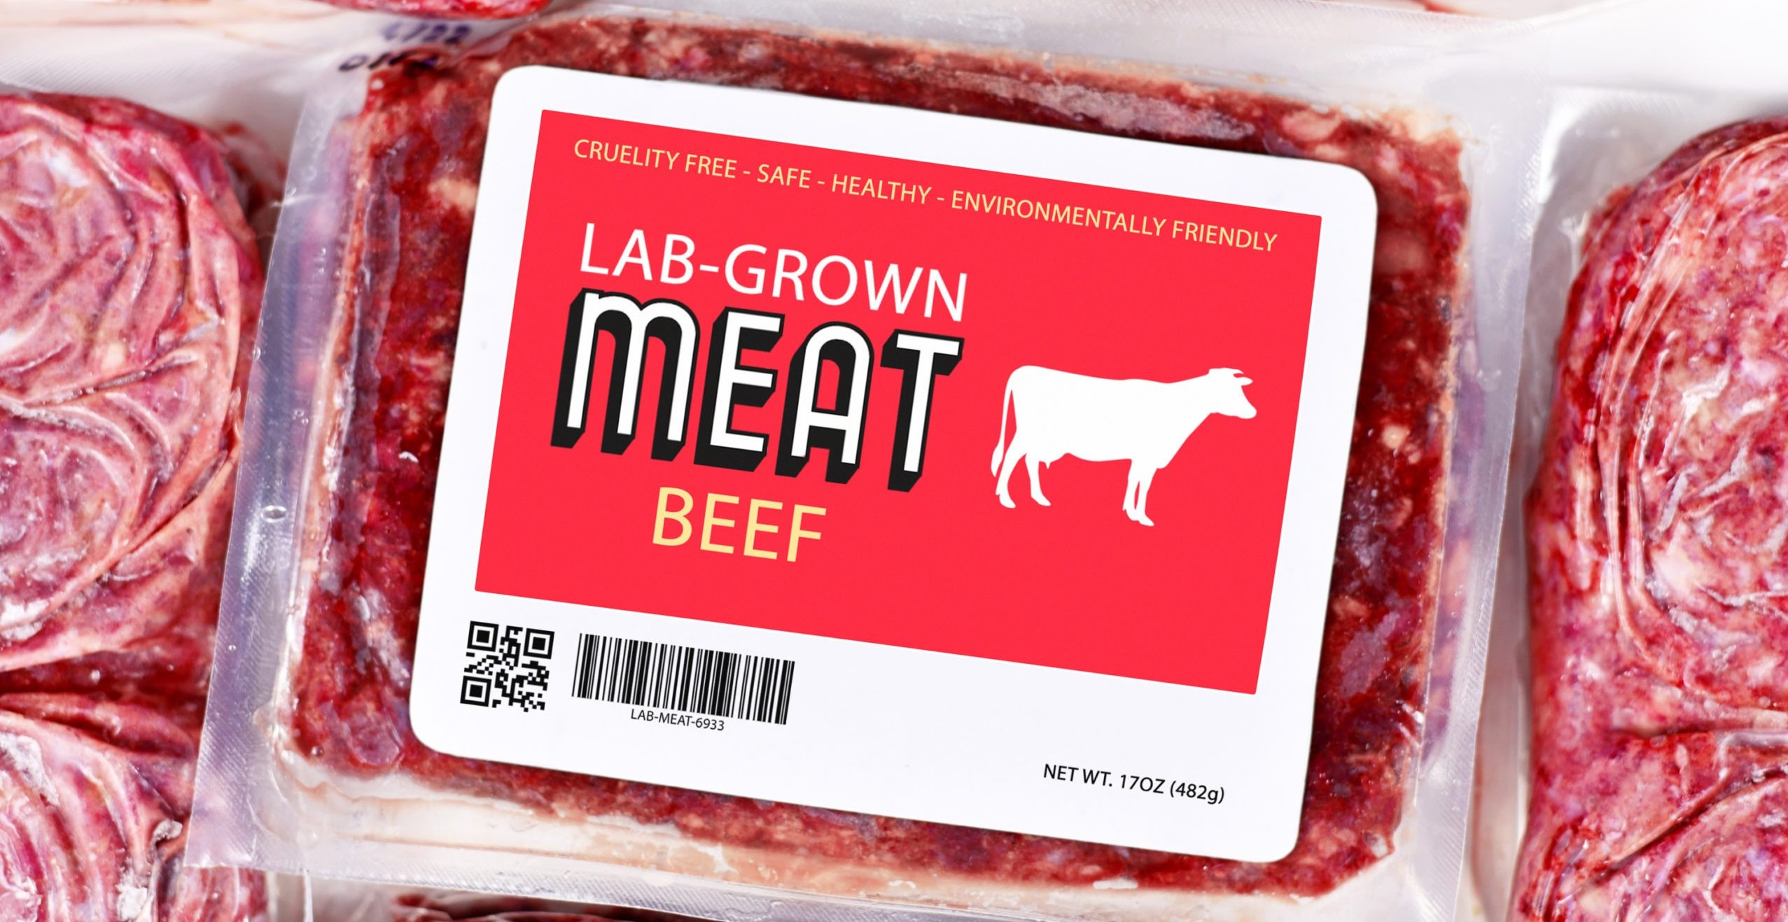
cultured meat
Cultured meat, also known as cell-based, clean, or cultivated meat, is produced by extracting cells from an animal via a harmless biopsy and growing them into meat cells.
This process offers a potential alternative to factory farming, and may alleviate the associated ethical, environmental, and social issues.
Despite not yet being commercially available, there has been a huge amount of interest in this new potential field, including from large investors such as Tyson Foods and Cargill.
Notes:
Cultured meat (also known by other names, see below) is a meat produced by in vitro cell cultures of animal cells.^{[1]} It is a form of cellular agriculture, with such agricultural methods being explored in the context of increased consumer demand for protein.^{[2]}
Cultured meat is produced using tissue engineering techniques traditionally used in regenerative medicines.^{[3]} The concept of cultured meat was introduced to wider audiences by Jason Matheny in the early 2000s after he co-authored a paper^{[4]} on cultured meat production and created New Harvest, the world's first nonprofit organization dedicated to in-vitro meat research.^{[5]}
Cultured meat may have the potential to address substantial global problems of the environmental impact of meat production, animal welfare, food security and human health.^{[6][7][8][9][10]} Specifically, it can be thought of in the context of the mitigation of climate change.^{[2]}
Lecture The Meat Revolution at the World Economic Forum by Mark Post of the University of Maastricht about in vitro meat. (Runtime 20:16)
A video by New Harvest / Xprize explaining the development of cultured meat and a "post-animal bio-economy, driven by lab grown protein (meat, eggs, milk)". (Runtime 3:09)
In 2013, professor Mark Post at Maastricht University pioneered a proof-of-concept for cultured meat by creating the first hamburger patty grown directly from cells. Since then, other cultured meat prototypes have gained media attention: SuperMeat opened a farm-to-fork restaurant called "The Chicken"^{[11]} in Tel Aviv to test consumer reaction to its "Chicken" burger,^{[12]} while the "world's first commercial sale of cell-cultured meat" occurred in December 2020 at the Singapore restaurant "1880", where cultured meat manufactured by the US firm Eat Just was sold.^{[13]}
While most efforts in the space focus on common meats such as pork, beef, and chicken which comprise the bulk of consumption in developed countries,^{[14]} some new companies such as Orbillion Bio have focused on high end or unusual meats including Elk, Lamb, Bison, and the prized Wagyu strain of beef.^{[15]} Avant Meats has brought cultured grouper fish to market ^{[16]} as other companies have started to pursue cultivating additional fish species and other seafood.^{[17]}
The production process is constantly evolving, driven by multiple companies and research institutions.^{[18]} The applications of cultured meat have led to ethical, health, environmental, cultural, and economic discussions.^{[19]} In terms of market strength, data published by the non-governmental organization Good Food Institute found that in 2021 cultivated meat companies attracted $140 million in Europe alone.

Slide 18
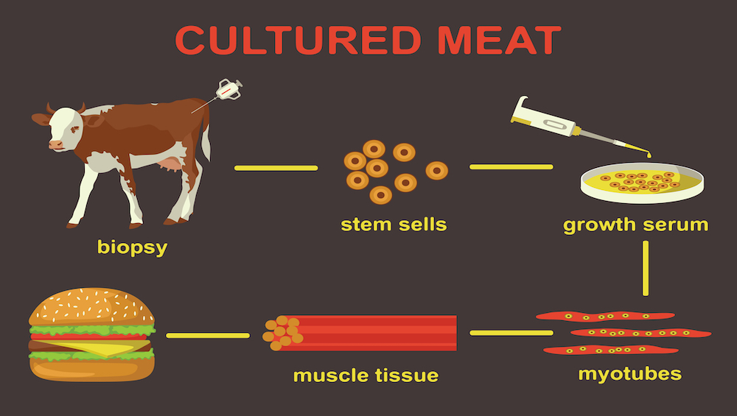
process
Notes:
Cultured meat (also known by other names, see below) is a meat produced by in vitro cell cultures of animal cells.^{[1]} It is a form of cellular agriculture, with such agricultural methods being explored in the context of increased consumer demand for protein.^{[2]}
Cultured meat is produced using tissue engineering techniques traditionally used in regenerative medicines.^{[3]} The concept of cultured meat was introduced to wider audiences by Jason Matheny in the early 2000s after he co-authored a paper^{[4]} on cultured meat production and created New Harvest, the world's first nonprofit organization dedicated to in-vitro meat research.^{[5]}
Cultured meat may have the potential to address substantial global problems of the environmental impact of meat production, animal welfare, food security and human health.^{[6][7][8][9][10]} Specifically, it can be thought of in the context of the mitigation of climate change.^{[2]}
Lecture The Meat Revolution at the World Economic Forum by Mark Post of the University of Maastricht about in vitro meat. (Runtime 20:16)
A video by New Harvest / Xprize explaining the development of cultured meat and a "post-animal bio-economy, driven by lab grown protein (meat, eggs, milk)". (Runtime 3:09)
In 2013, professor Mark Post at Maastricht University pioneered a proof-of-concept for cultured meat by creating the first hamburger patty grown directly from cells. Since then, other cultured meat prototypes have gained media attention: SuperMeat opened a farm-to-fork restaurant called "The Chicken"^{[11]} in Tel Aviv to test consumer reaction to its "Chicken" burger,^{[12]} while the "world's first commercial sale of cell-cultured meat" occurred in December 2020 at the Singapore restaurant "1880", where cultured meat manufactured by the US firm Eat Just was sold.^{[13]}
While most efforts in the space focus on common meats such as pork, beef, and chicken which comprise the bulk of consumption in developed countries,^{[14]} some new companies such as Orbillion Bio have focused on high end or unusual meats including Elk, Lamb, Bison, and the prized Wagyu strain of beef.^{[15]} Avant Meats has brought cultured grouper fish to market ^{[16]} as other companies have started to pursue cultivating additional fish species and other seafood.^{[17]}
The production process is constantly evolving, driven by multiple companies and research institutions.^{[18]} The applications of cultured meat have led to ethical, health, environmental, cultural, and economic discussions.^{[19]} In terms of market strength, data published by the non-governmental organization Good Food Institute found that in 2021 cultivated meat companies attracted $140 million in Europe alone.

Slide 19
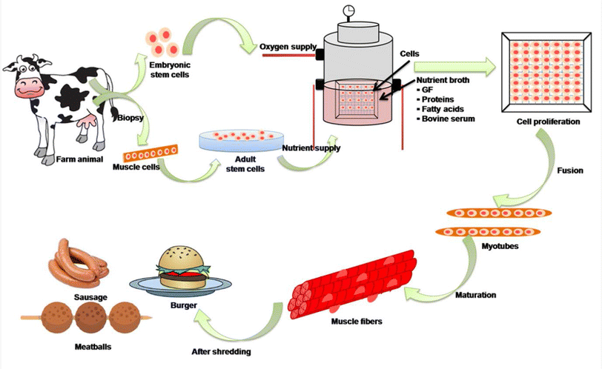
process
Notes:
Cultured meat (also known by other names, see below) is a meat produced by in vitro cell cultures of animal cells.^{[1]} It is a form of cellular agriculture, with such agricultural methods being explored in the context of increased consumer demand for protein.^{[2]}
Cultured meat is produced using tissue engineering techniques traditionally used in regenerative medicines.^{[3]} The concept of cultured meat was introduced to wider audiences by Jason Matheny in the early 2000s after he co-authored a paper^{[4]} on cultured meat production and created New Harvest, the world's first nonprofit organization dedicated to in-vitro meat research.^{[5]}
Cultured meat may have the potential to address substantial global problems of the environmental impact of meat production, animal welfare, food security and human health.^{[6][7][8][9][10]} Specifically, it can be thought of in the context of the mitigation of climate change.^{[2]}
Lecture The Meat Revolution at the World Economic Forum by Mark Post of the University of Maastricht about in vitro meat. (Runtime 20:16)
A video by New Harvest / Xprize explaining the development of cultured meat and a "post-animal bio-economy, driven by lab grown protein (meat, eggs, milk)". (Runtime 3:09)
In 2013, professor Mark Post at Maastricht University pioneered a proof-of-concept for cultured meat by creating the first hamburger patty grown directly from cells. Since then, other cultured meat prototypes have gained media attention: SuperMeat opened a farm-to-fork restaurant called "The Chicken"^{[11]} in Tel Aviv to test consumer reaction to its "Chicken" burger,^{[12]} while the "world's first commercial sale of cell-cultured meat" occurred in December 2020 at the Singapore restaurant "1880", where cultured meat manufactured by the US firm Eat Just was sold.^{[13]}
While most efforts in the space focus on common meats such as pork, beef, and chicken which comprise the bulk of consumption in developed countries,^{[14]} some new companies such as Orbillion Bio have focused on high end or unusual meats including Elk, Lamb, Bison, and the prized Wagyu strain of beef.^{[15]} Avant Meats has brought cultured grouper fish to market ^{[16]} as other companies have started to pursue cultivating additional fish species and other seafood.^{[17]}
The production process is constantly evolving, driven by multiple companies and research institutions.^{[18]} The applications of cultured meat have led to ethical, health, environmental, cultural, and economic discussions.^{[19]} In terms of market strength, data published by the non-governmental organization Good Food Institute found that in 2021 cultivated meat companies attracted $140 million in Europe alone.

Slide 20
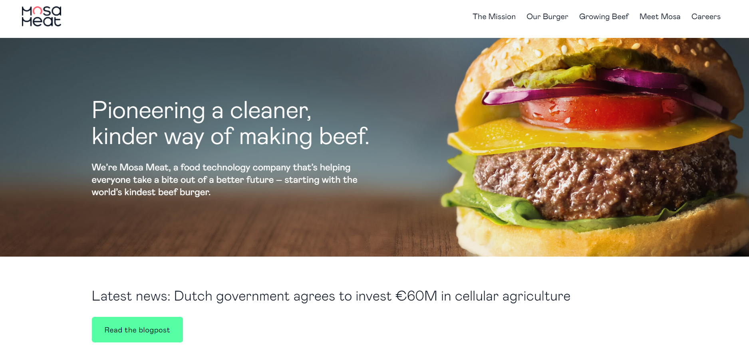
brand: Mosa Meat (Netherlands)

Slide 21
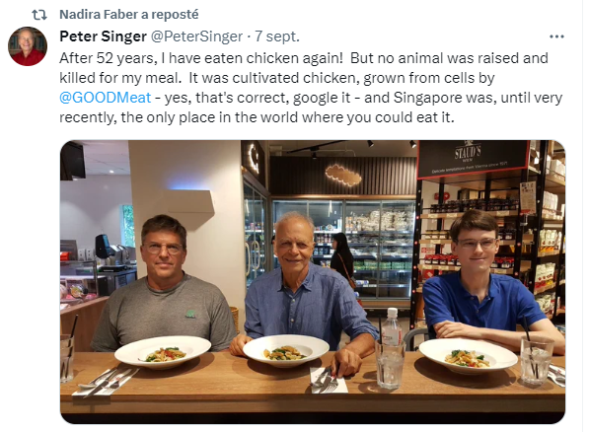

Slide 22
Your job: R class: What are the drivers and barriers to eating alternatives to meat? Consumer bheavior class: Make recommendations Launch the product

Slide 23
Course organization
8 groups
Assignment: R -> R code
Assignment Consumer behavior -> Group presentation (Selling your product / concept )

Slide 24
All the groups will send their code
before November 7th Noon
Campus

Slide 25

Challenge
The class (and I) will vote for the best creative idea!!
The winner-group willl get a 2 point-bonus

Slide 26
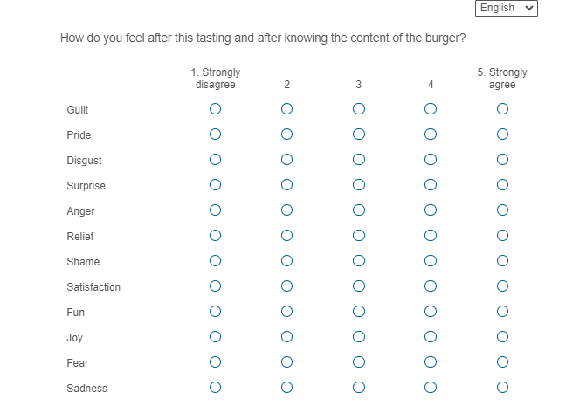
Understanding how variables are measured What concept is this ?

Slide 27
Understanding how variables are measured EMOTIONS!

Slide 28
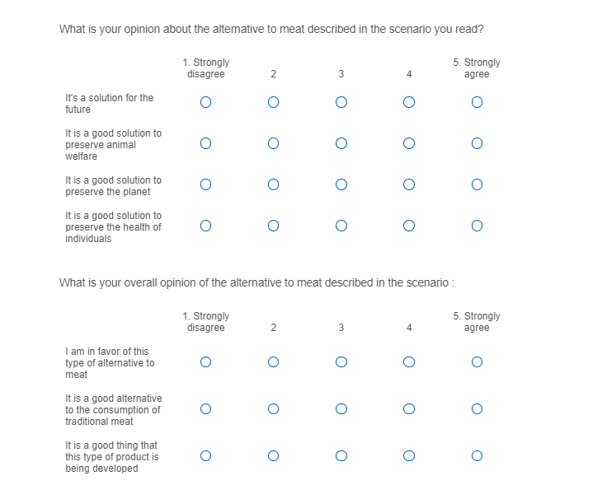
Understanding how variables are measured What concept is this ?

Slide 29
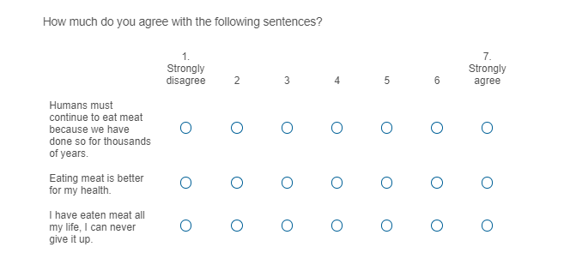
Understanding how variables are measured What concept is this ?

Slide 30
Understanding how variables are measured BELIEFS alternatives to meat
BELIEFS Meat

Slide 31
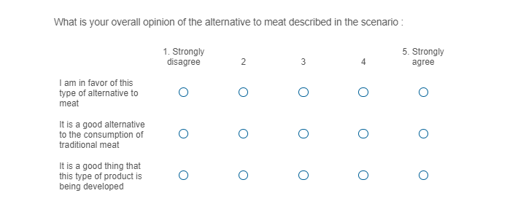
Understanding how variables are measured What concept is this ?

Slide 32
Understanding how variables are measured ATTITUDES!

Slide 33
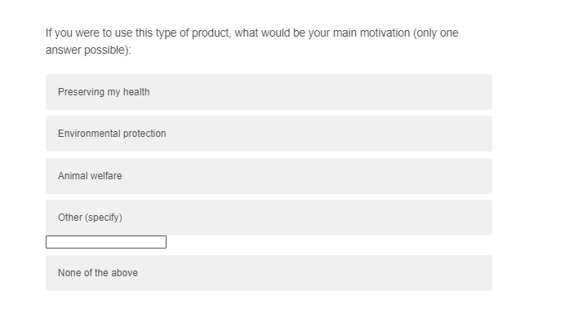
Understanding how variables are measured What concept is this ?

Slide 34
Understanding how variables are measured MOTIVATIONS!

Slide 35
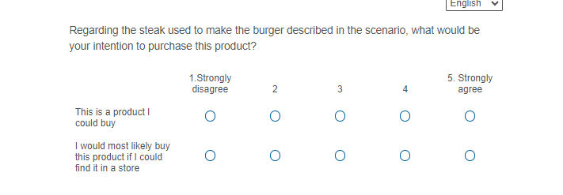
Understanding how variables are measured What concept is this ?

Slide 36
Understanding how variables are measured PURCHASE INTENTIONS!

Slide 37
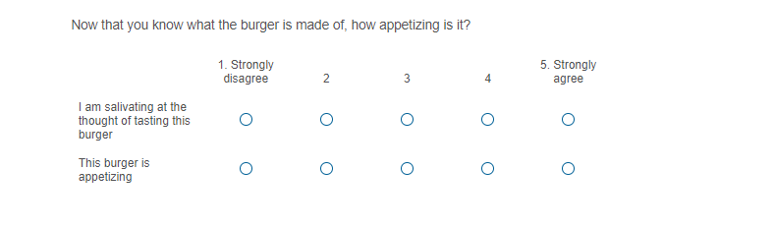
Understanding how variables are measured What concept is this ?

Slide 38
Understanding how variables are measured LIKING

Slide 39
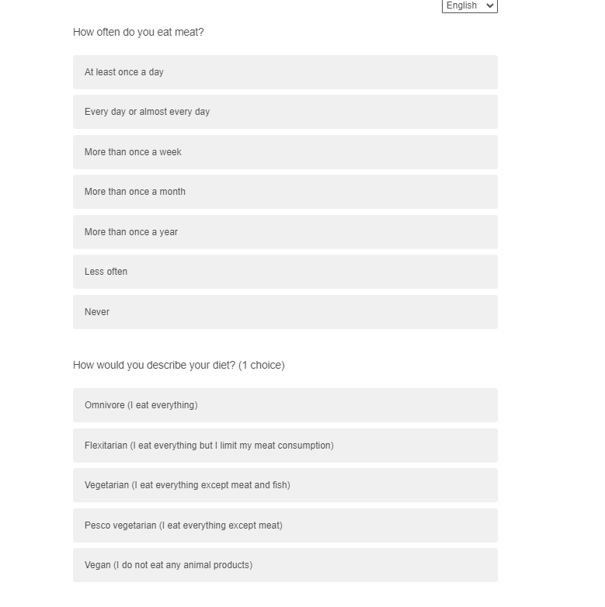
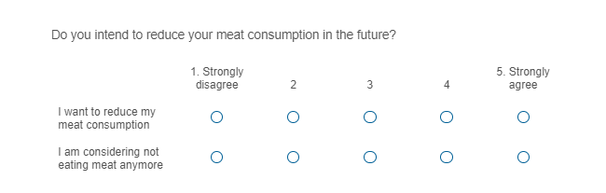
Understanding how variables are measured What concept is this ?

Slide 40
Understanding how variables are measured PAST and FUTURE BEHAVIOR

Slide 41
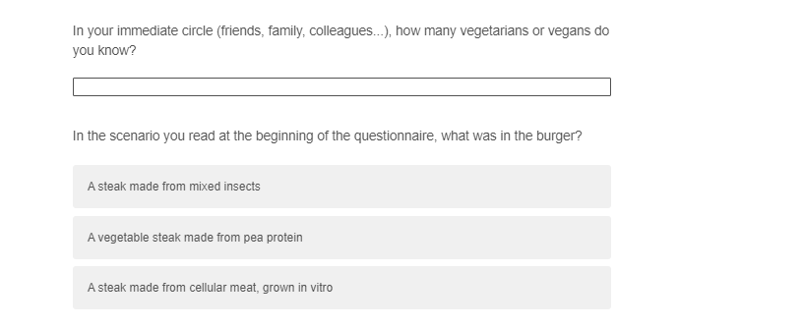
Understanding how variables are measured What concept is this ?

Slide 42
Understanding how variables are measured SOCIAL INFLUENCE MANIP CHECK

Slide 43
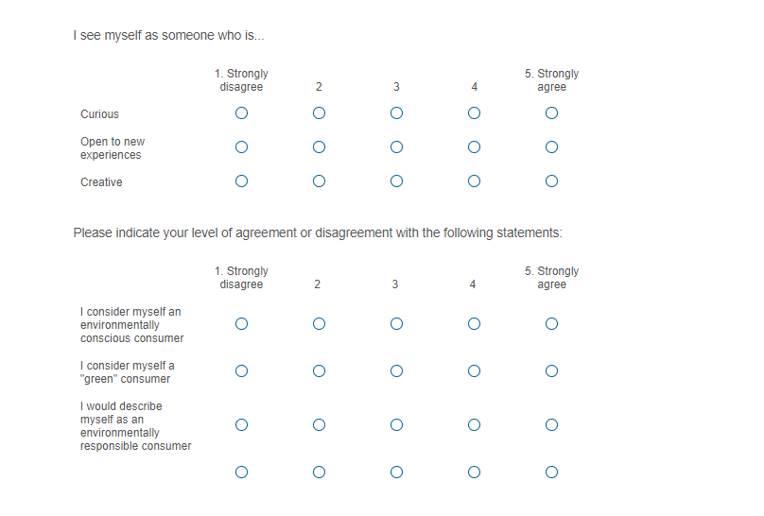
Understanding how variables are measured Personality & self-concept

Slide 44
Understanding how variables are measured Personality & self-concept

Slide 45
Your assignment (R class)
Which variables are mostly likely to explain consumers’ decision-making process (for the meat alternative of your choice)?
- What are the main motivations to eat the meat alternative of your choice?
- What are the main barriers to eat the meat alternative of your choice?
Summarize the data
Compare groups
Draw a mediation model with expected links between the variables and test the model

